Slide 1
Retailer Feedback

Slide 2
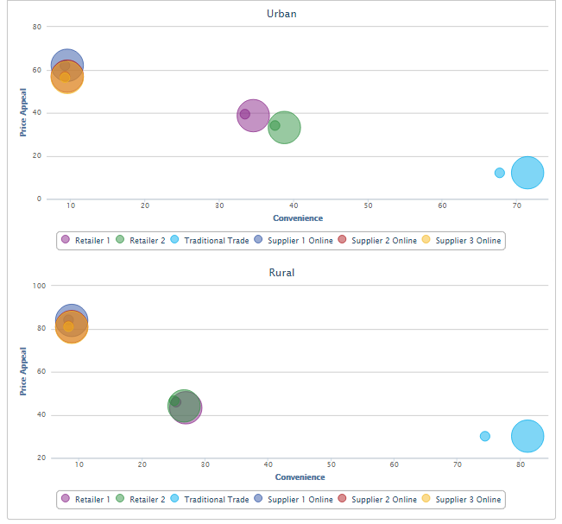
1. Store Perceptions

Slide 3
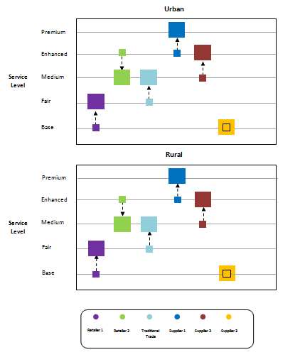
2. Service Levels

Slide 4
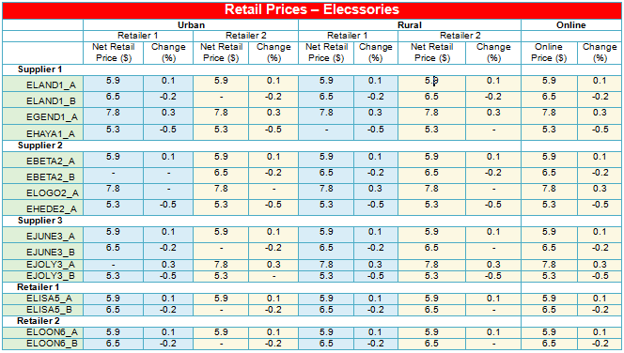
3. Net Retail Prices - Elecssories

Slide 5
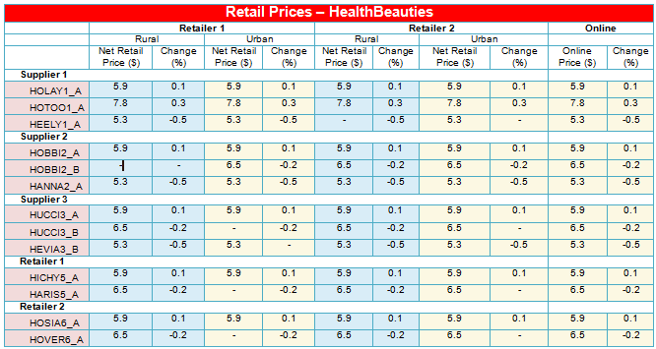
3. Net Retail Prices - HealthBeauties

Slide 6
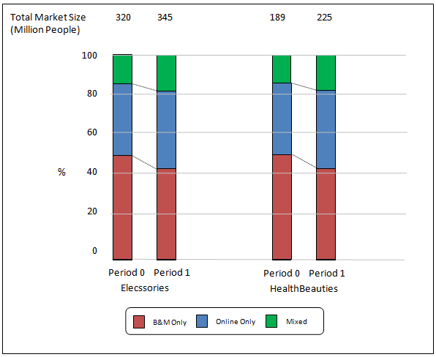
4. Shopper Segment Evolution – Urban

Slide 7
4. Shopper Segment Evolution – Rural

Slide 8
5. Share of Shoppers – Urban Market
Elecssories

Slide 9
5. Share of Shoppers – Urban Market
HealthBeauties

Slide 10
5. Share of Shoppers – Rural Market
Elecssories

Slide 11
5. Share of Shoppers – Rural Market
HealthBeauties

Slide 12
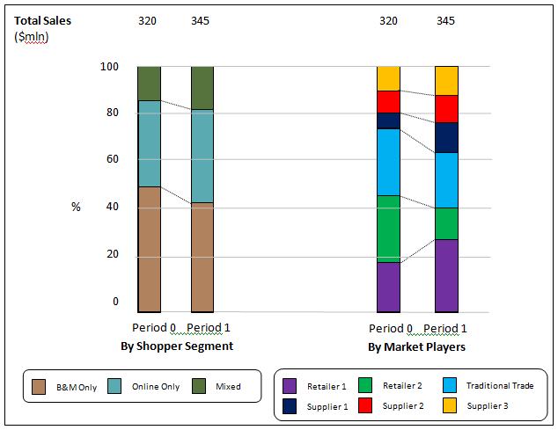
6. Retail Sales – Urban - Elecssories

Slide 13
6. Retail Sales – Urban - HealthBeauties

Slide 14
6. Retail Sales – Rural- Elecssories

Slide 15
6. Retail Sales – Rural - HealthBeauties

Slide 16
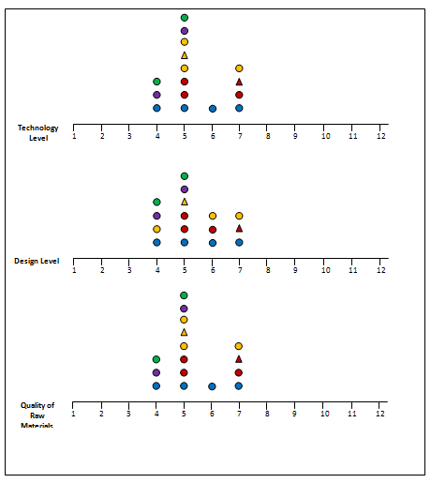
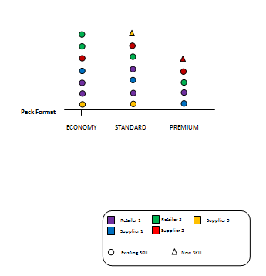
7. Available Product Portfolio - Elecssories

Slide 17
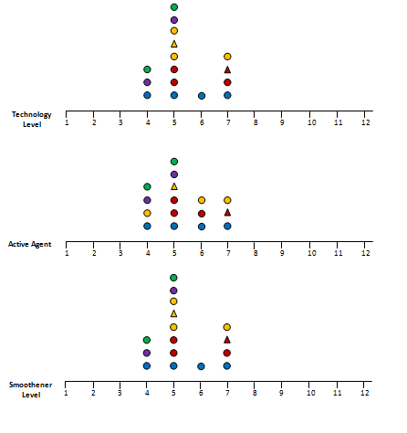
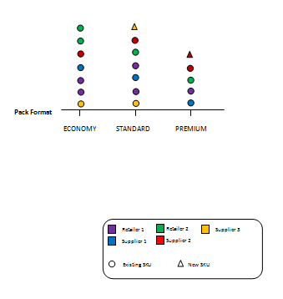
7. Available Product Portfolio - HealthBeauties

Slide 18
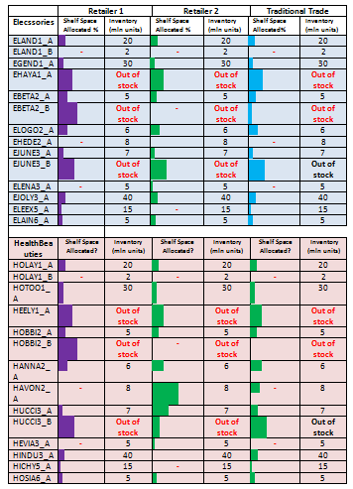
8. Product Availability at Stores – Urban

Slide 19
8. Product Availability at Stores – Rural

Slide 20
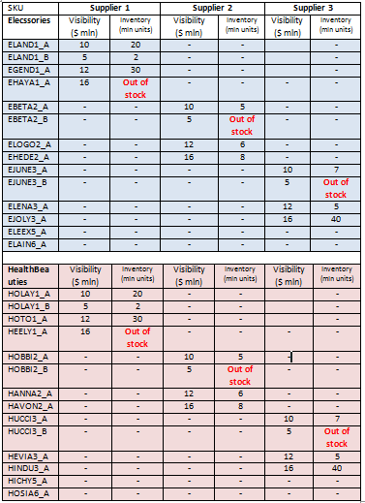
8. Product Availability at Stores – Online

Slide 21
9. Partner Relations & Outcomes
Volume Discounts
Total Volume Discount: 187.95 ($ mln)
Performance Bonus
Total Performance Bonus: 187.95 ($ mln)
Other Compensation
Total Other Compensation: 187.95 ($ mln)

Slide 22
9. Partner Relations & Outcomes – Terms of Payment

Slide 23
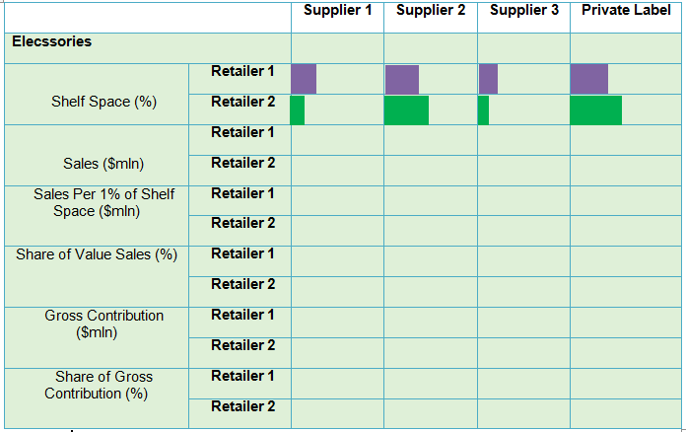
9. Partner Relations & Outcomes – Elecssories - Urban

Slide 24
9. Partner Relations & Outcomes – Elecssories - Rural

Slide 25
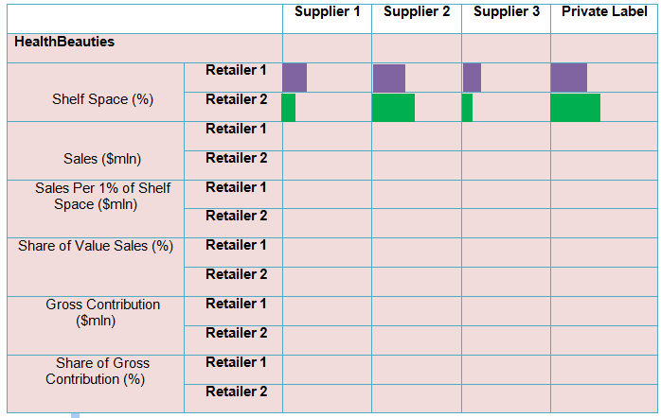
9. Partner Relations & Outcomes – HealthBeauties - Urban

Slide 26
9. Partner Relations & Outcomes – HealthBeauties - Rural

Slide 27
10. Promotional Activities – Elecssories - Urban
 | Retailer 1 |  | Retailer 2
 | Length | Depth (%) | Length | Depth (%)
Supplier 1
ELAND1_A
ELAND1_B
EGEND1_A
EHAYA1_A
Supplier 2
EBETA2_A
EBETA2_B
ELOGO2_A
EHEDE2_A
Supplier 3
EJUNE3_A
EJUNE3_B
EJOLY3_A
EJOLY3_B
Retailer 1
ELISA5_A
ELISA5_B
Retailer 2
ELOON6_A
ELANG6_B

Slide 28
10. Promotional Activities – Elecssories - Rural
 | Retailer 1 |  | Retailer 2
 | Length | Depth (%) | Length | Depth (%)
Supplier 1
ELAND1_A
ELAND1_B
EGEND1_A
EHAYA1_A
Supplier 2
EBETA2_A
EBETA2_B
ELOGO2_A
EHEDE2_A
Supplier 3
EJUNE3_A
EJUNE3_B
EJOLY3_A
EJOLY3_B
Retailer 1
ELISA5_A
ELISA5_B
Retailer 2
ELOON6_A
ELANG6_B

Slide 29
10. Promotional Activities – HealthBeauties- Urban
 | Retailer 1 |  | Retailer 2
 | Length | Depth (%) | Length | Depth (%)
Supplier 1
ELAND1_A
ELAND1_B
EGEND1_A
EHAYA1_A
Supplier 2
EBETA2_A
EBETA2_B
ELOGO2_A
EHEDE2_A
Supplier 3
EJUNE3_A
EJUNE3_B
EJOLY3_A
EJOLY3_B
Retailer 1
ELISA5_A
ELISA5_B
Retailer 2
ELOON6_A
ELANG6_B

Slide 30
10. Promotional Activities – HealthBeauties- Rural
 | Retailer 1 |  | Retailer 2
 | Length | Depth (%) | Length | Depth (%)
Supplier 1
ELAND1_A
ELAND1_B
EGEND1_A
EHAYA1_A
Supplier 2
EBETA2_A
EBETA2_B
ELOGO2_A
EHEDE2_A
Supplier 3
EJUNE3_A
EJUNE3_B
EJOLY3_A
EJOLY3_B
Retailer 1
ELISA5_A
ELISA5_B
Retailer 2
ELOON6_A
ELANG6_B

Slide 31
10. Retailer Local Advertising
Urban Market
Rural Market
10
8
6
4
2
0
$ mln
Period 0 Period 1 Period 0 Period 1
Period 0 Period 1 Period 0 Period 1
Retailer 1
Retailer 2

Slide 32
11. Profits – Gross Profits
Gross Profits
(B&M – Modern Retailers)
Urban Market
(B&M – Modern Retailers)
Rural Market
(B&M – Modern Retailers)
Total Market
Online Market
10
8
6
4
2
0
$ mln
Period
0 1 0 1
0 1 0 1
0 1 0 1
0 1
Retailer 1
Retailer 2
Retailer 1
Retailer 2
Retailer 1
Retailer 2
Retailer 1
Retailer 2
Supplier 1
Supplier 2
Supplier 3

Slide 33
11. Profits – Operating Profits
Gross Profits
(B&M – Modern Retailers)
Urban Market
(B&M – Modern Retailers)
Rural Market
(B&M – Modern Retailers)
Total Market
Online Market
10
8
6
4
2
0
$ mln
Period
0 1 0 1
0 1 0 1
0 1 0 1
0 1
Retailer 1
Retailer 2
Retailer 1
Retailer 2
Retailer 1
Retailer 2
Retailer 1
Retailer 2
Supplier 1
Supplier 2
Supplier 3

Slide 34
11. Profits – Net Profits
Gross Profits
(B&M – Modern Retailers)
Urban Market
(B&M – Modern Retailers)
Rural Market
(B&M – Modern Retailers)
Total Market
Online Market
10
8
6
4
2
0
$ mln
Period
0 1 0 1
0 1 0 1
0 1 0 1
0 1
Retailer 1
Retailer 2
Retailer 1
Retailer 2
Retailer 1
Retailer 2
Retailer 1
Retailer 2
Supplier 1
Supplier 2
Supplier 3

Slide 35
11. Profits – Margins

Slide 36
12. KPIs – Rotation Index
Elecssories
Sales Value
Sales Volume
Rural Market
Urban Market
Rural Market
Urban Market
HealthBeauties
Sales Value
Sales Volume
Rural Market
Urban Market
Rural Market
Urban Market

Slide 37
12. KPIs – Profitability Index

Slide 38
12. KPIs – Stock Cover

Slide 39
Supplier Feedback

Slide 40
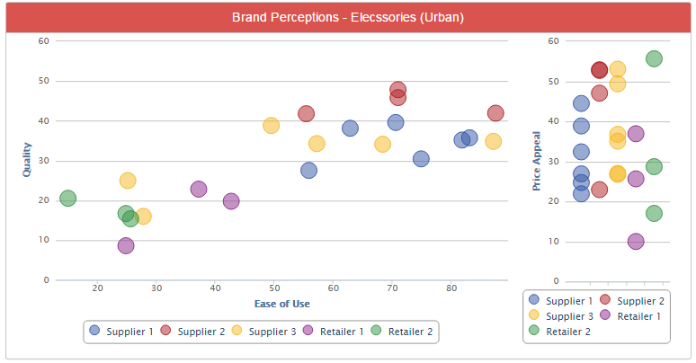
1. Brand Perceptions – Elecssories - Urban

Slide 41
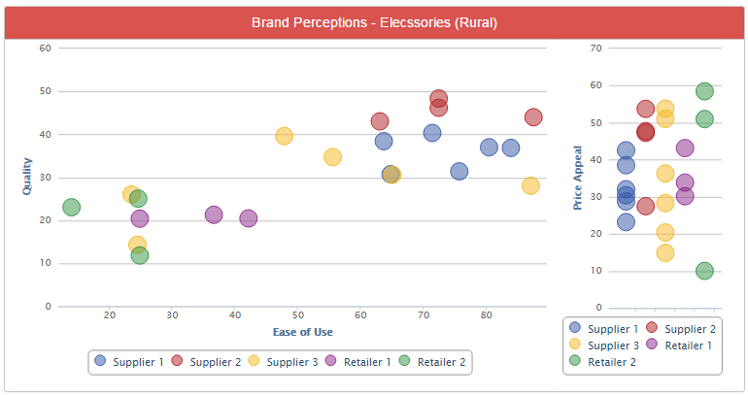
1. Brand Perceptions – Elecssories - Rural

Slide 42
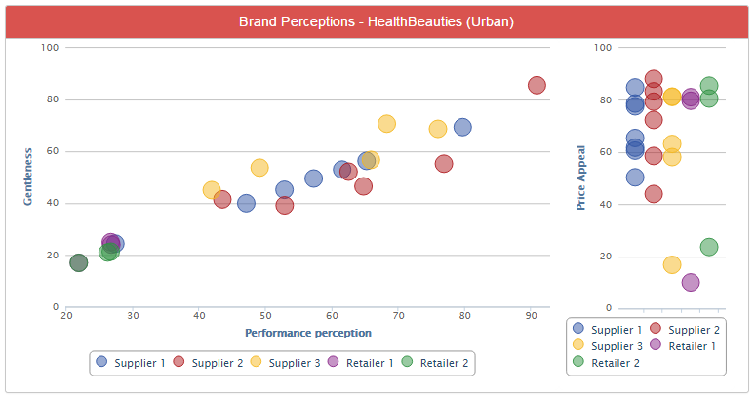
1. Brand Perceptions – HealthBeauties- Urban

Slide 43
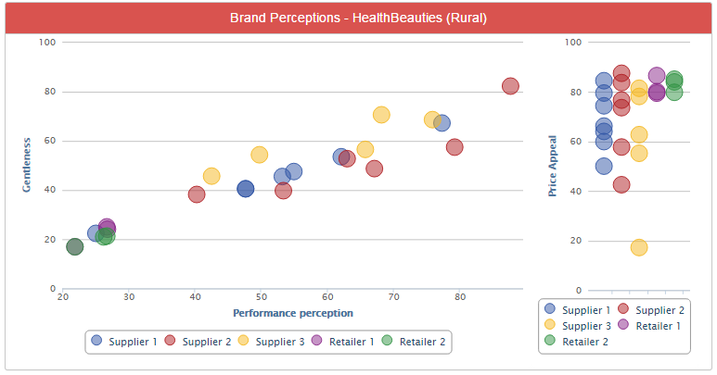
1. Brand Perceptions – HealthBeauties- Rural

Slide 44
2. Net Retail Prices - Elecssories

Slide 45
3. Net Retail Prices - HealthBeauties

Slide 46
3. Available Product Portfolio - Elecssories

Slide 47
3. Available Product Portfolio - HealthBeauties

Slide 48
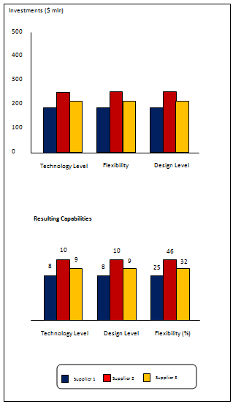
4. Capital Investments

Slide 49
5. Market Evolution – Consumer Segment
Elecssories - Urban
Elecssories - Rural
HealthBeauties- Urban
HealthBeauties- Rural

Slide 50
5. Market Evolution – Shopper Segment
Elecssories - Urban
Elecssories - Rural
HealthBeauties- Urban
HealthBeauties- Rural

Slide 51
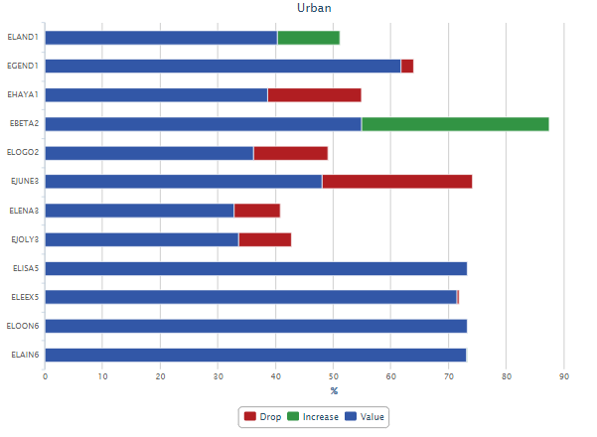
6. Awareness – Elecssories - Urban

Slide 52
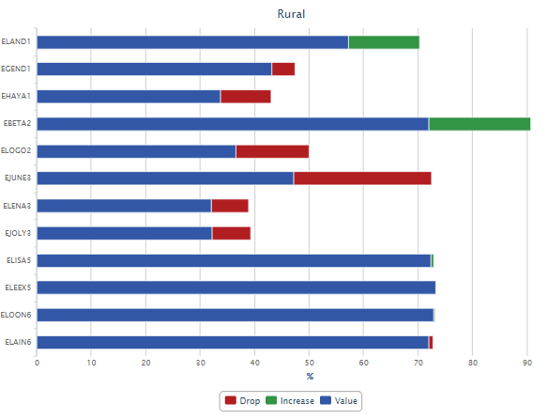
6. Awareness – Elecssories - Rural

Slide 53
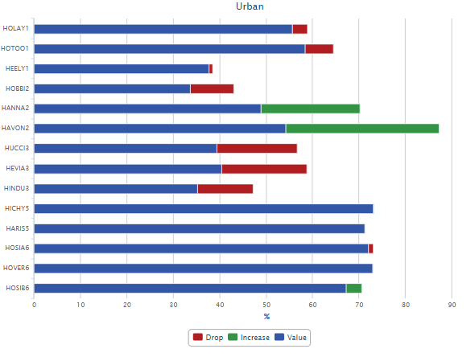
6. Awareness – HealthBeauties- Urban

Slide 54
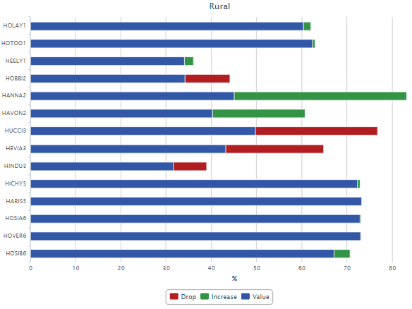
6. Awareness – HealthBeauties- Rural

Slide 55
7. Product Availability at Stores – Urban

Slide 56
7. Product Availability at Stores – Rural

Slide 57
7. Product Availability at Stores – Online

Slide 58
8. Partner Relations & Outcomes
Volume Discounts
Total Volume Discount: 187.95 ($ mln)
Performance Bonus
Total Performance Bonus: 187.95 ($ mln)
Other Compensation
Total Other Compensation: 187.95 ($ mln)

Slide 59
8. Partner Relations & Outcomes – Terms of Payment

Slide 60
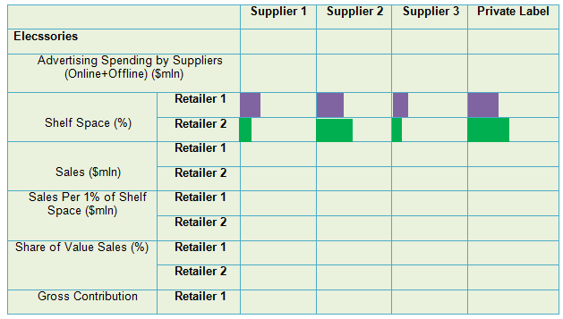
8. Partner Relations & Outcomes – Elecssories - Urban

Slide 61
8. Partner Relations & Outcomes – Elecssories - Rural

Slide 62
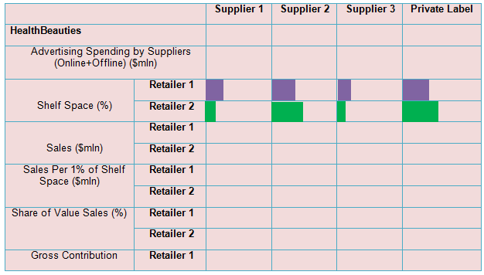
8. Partner Relations & Outcomes – HealthBeauties - Urban

Slide 63
8. Partner Relations & Outcomes – HealthBeauties - Rural

Slide 64
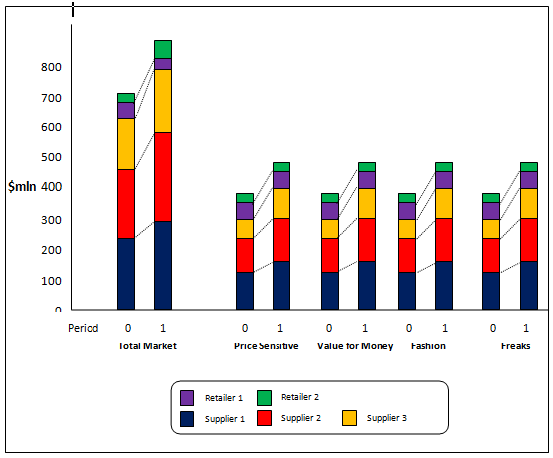
9. Retail Sales of Brands - Elecssories

Slide 65
9. Retail Sales of Brands - HealthBeauties

Slide 66
10. Financials – Sales - Elecssories
Sales
10
8
6
4
2
0
$ mln
Period
0 1
0 1
0 1
0 1
0 1
Supplier 1
Supplier 2
Supplier 3
Retailer 1
Retailer 2
Retailer 1
Retailer 2
Traditional Trade
Online

Slide 67
10. Financials – Sales - HealthBeauties
Sales
10
8
6
4
2
0
$ mln
Period
0 1
0 1
0 1
0 1
0 1
Supplier 1
Supplier 2
Supplier 3
Retailer 1
Retailer 2
Retailer 1
Retailer 2
Traditional Trade
Online

Slide 68
10. Financials – Gross Profits- Elecssories
Sales
10
8
6
4
2
0
$ mln
Period
0 1
0 1
0 1
0 1
0 1
Supplier 1
Supplier 2
Supplier 3
Retailer 1
Retailer 2
Retailer 1
Retailer 2
Traditional Trade
Online

Slide 69
10. Financials – Gross Profits- HealthBeauties
Sales
10
8
6
4
2
0
$ mln
Period
0 1
0 1
0 1
0 1
0 1
Supplier 1
Supplier 2
Supplier 3
Retailer 1
Retailer 2
Retailer 1
Retailer 2
Traditional Trade
Online

Slide 70
10. Financials – Operating Profits- Elecssories
Sales
10
8
6
4
2
0
$ mln
Period
0 1
0 1
0 1
0 1
0 1
Supplier 1
Supplier 2
Supplier 3
Retailer 1
Retailer 2
Retailer 1
Retailer 2
Traditional Trade
Online

Slide 71
10. Financials – Operating Profits- HealthBeauties
Sales
10
8
6
4
2
0
$ mln
Period
0 1
0 1
0 1
0 1
0 1
Supplier 1
Supplier 2
Supplier 3
Retailer 1
Retailer 2
Retailer 1
Retailer 2
Traditional Trade
Online

Slide 72
10. Financials – Net Profits- Elecssories
Sales
10
8
6
4
2
0
$ mln
Period
0 1
0 1
0 1
0 1
0 1
Supplier 1
Supplier 2
Supplier 3
Retailer 1
Retailer 2
Retailer 1
Retailer 2
Traditional Trade
Online

Slide 73
10. Financials – Net Profits- HealthBeauties
Sales
10
8
6
4
2
0
$ mln
Period
0 1
0 1
0 1
0 1
0 1
Supplier 1
Supplier 2
Supplier 3
Retailer 1
Retailer 2
Retailer 1
Retailer 2
Traditional Trade
Online

Slide 74
10. KPI’s – Portfolio Strength

Slide 75
10. KPI’s – B&M Channel Strength
Elecssories
Share of Value Sales
Share of Volume Sales
Share of Shoppers
100
90
80
70
60
50
40
30
20
10
0
%
HealthBeauties
Share of Value Sales
Share of Volume Sales
Share of Shoppers
100
90
80
70
60
50
40
30
20
10
0
%

Slide 76
10. KPI’s – Online Channel Strength
Elecssories
Share of Value Sales
Share of Volume Sales
Share of Shoppers
100
90
80
70
60
50
40
30
20
10
0
%
HealthBeauties
Share of Value Sales
Share of Volume Sales
Share of Shoppers
100
90
80
70
60
50
40
30
20
10
0
%

Slide 77
Impact of eMall on Retailers – Sales (Volume)

Slide 78
Impact of eMall on Retailers – Sales (Value)

Slide 79
Impact of eMall on Retailers – Net Profits

Slide 80

Final Scores
Supplier Scores
 | Incremental market Share (IMS) | Return on Operational Budget (ROOB) | Portfolio Strength (PS) | Channel Strength (CS) | Final Score
Weight | 35% | 35% | 15% | 15%
Supplier 1
Supplier 2
Supplier 3
Retailer Scores
 | Incremental market Share (IMS) | Return on Operational Budget (ROOB) | Relative Profitability (RP) | Shopper Base (Share of Pocket SOP) | Final Score
Weight | 35% | 35% | 15% | 15%
Retailer 1
Retailer2

